Slide 1
Elastic Net results for each eye
Adam Shah

Slide 2
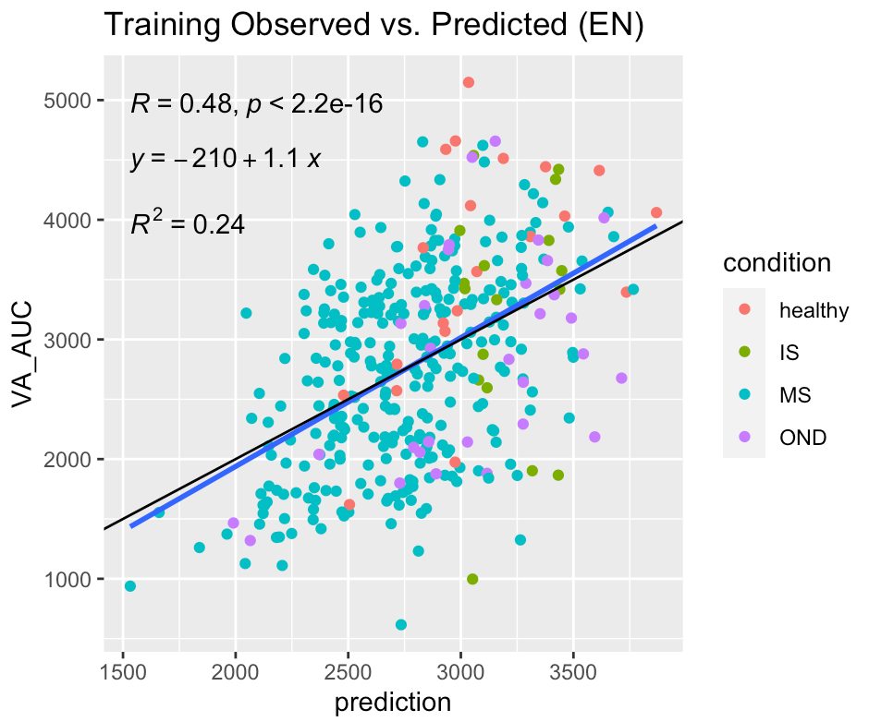
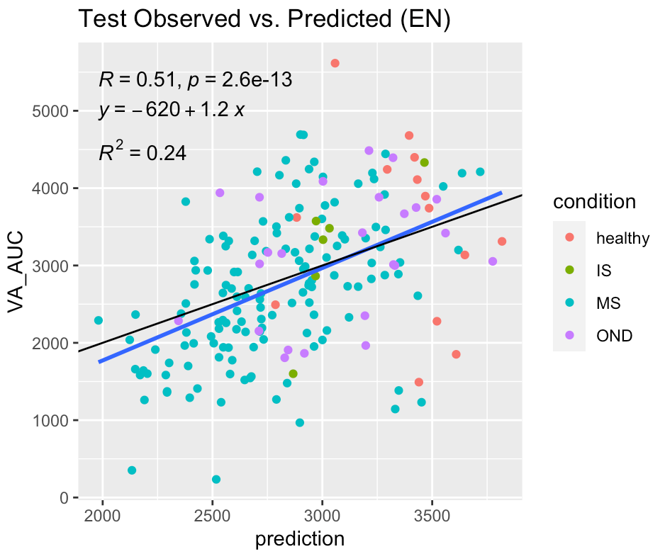
Fit for both eyes with diagnosis/condition
*black line is y=x reference line, blue line is regression line

Slide 3
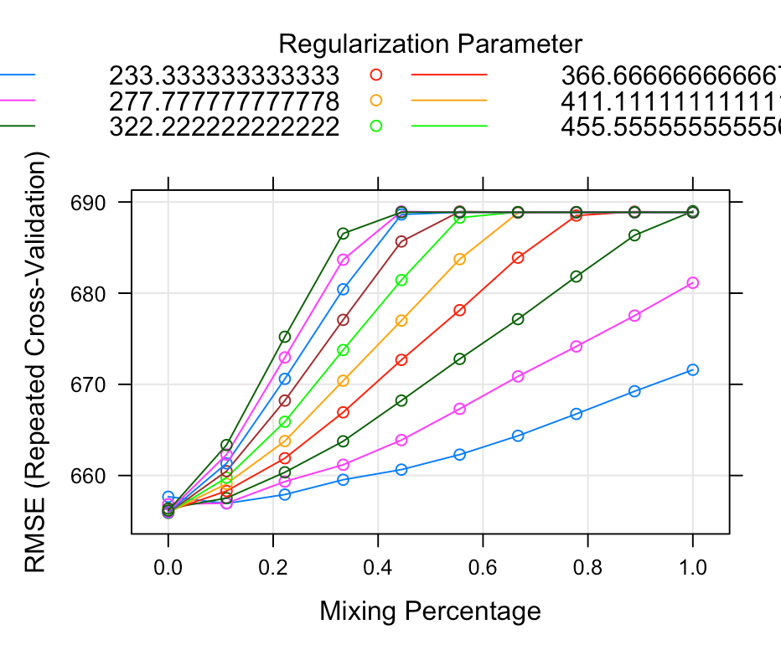
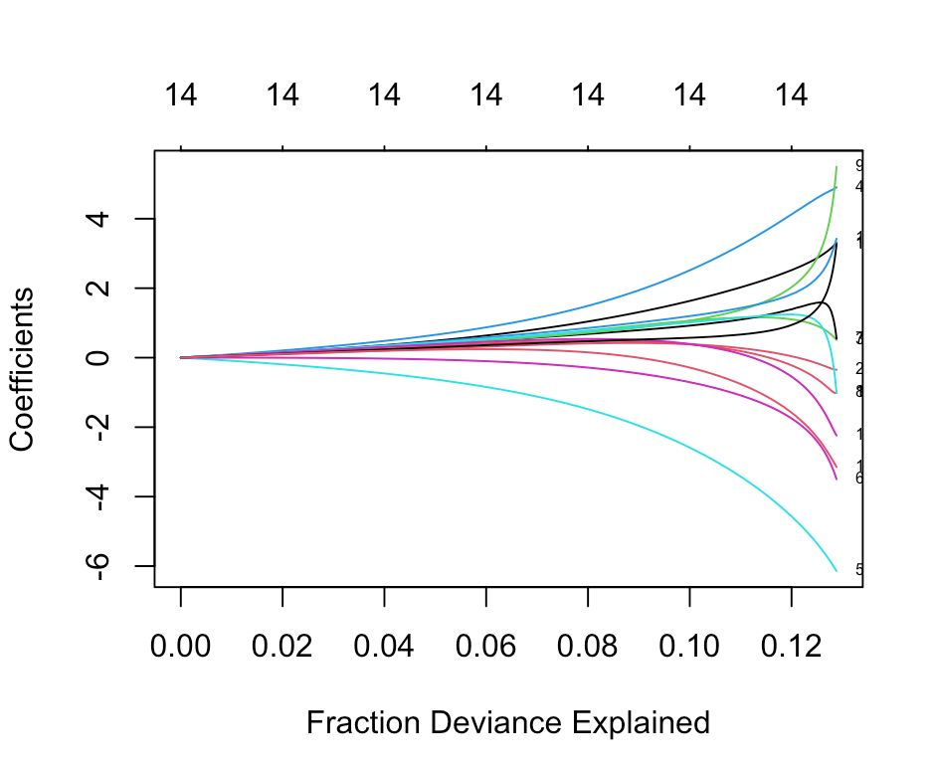
Determining parameters for right eye
Alpha=0, lambda=322

Slide 4
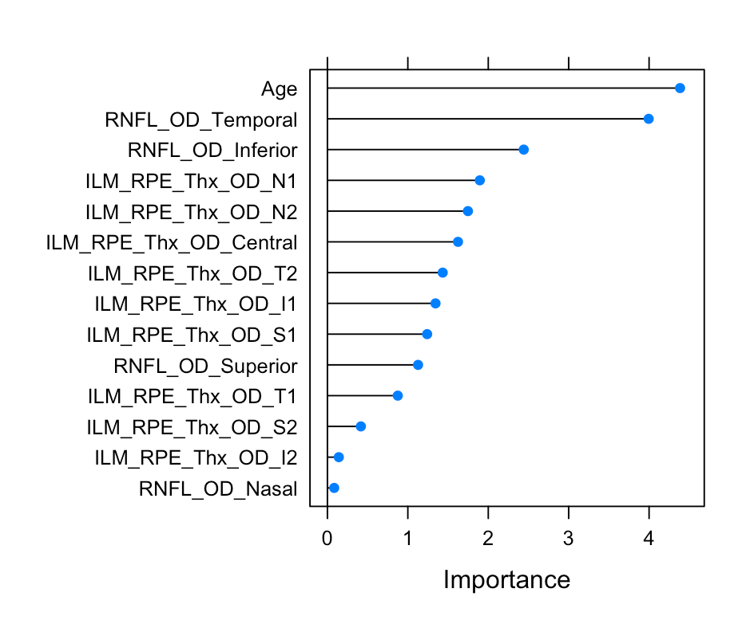
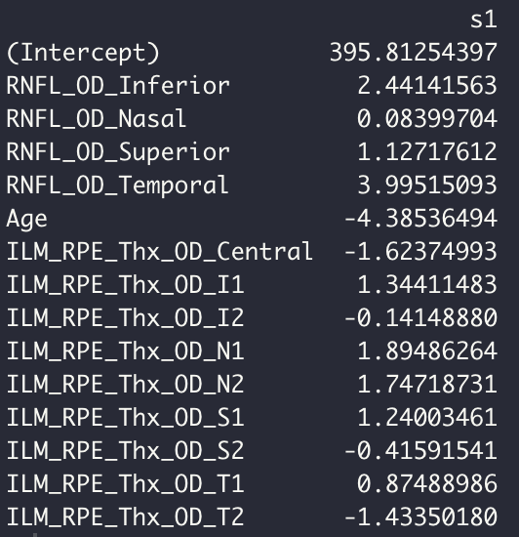
Importance of variables and coefficients (OD)

Slide 5
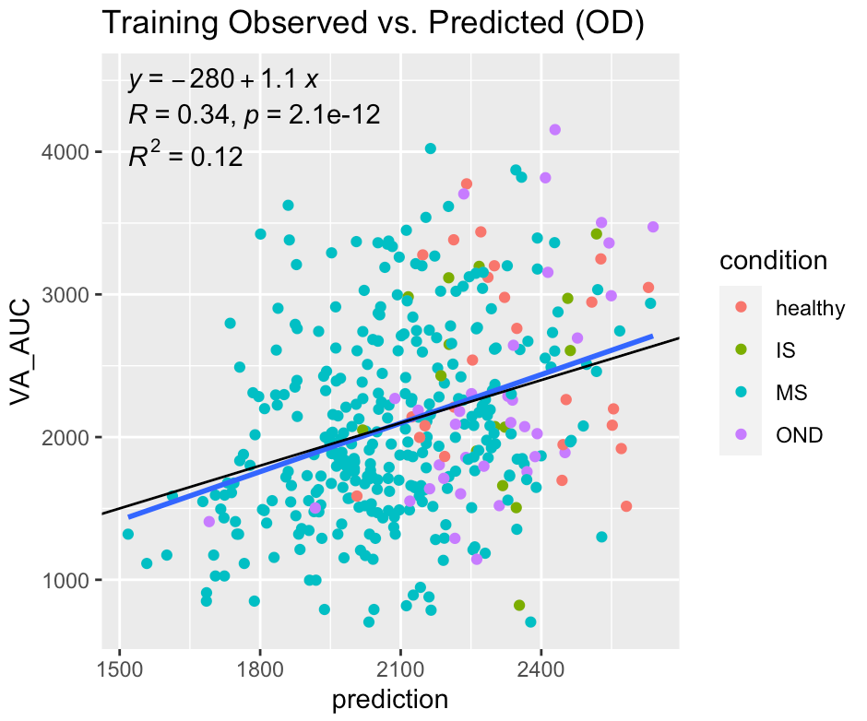
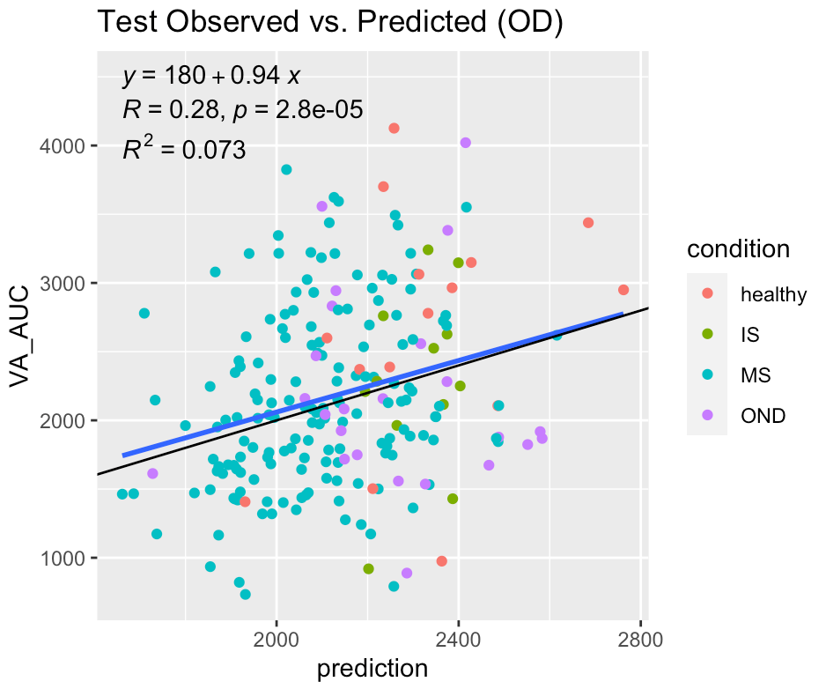


Fit for Training vs. Testing data for right eye
RMSE ->
*black line is y=x reference line, blue line is regression line

Slide 6
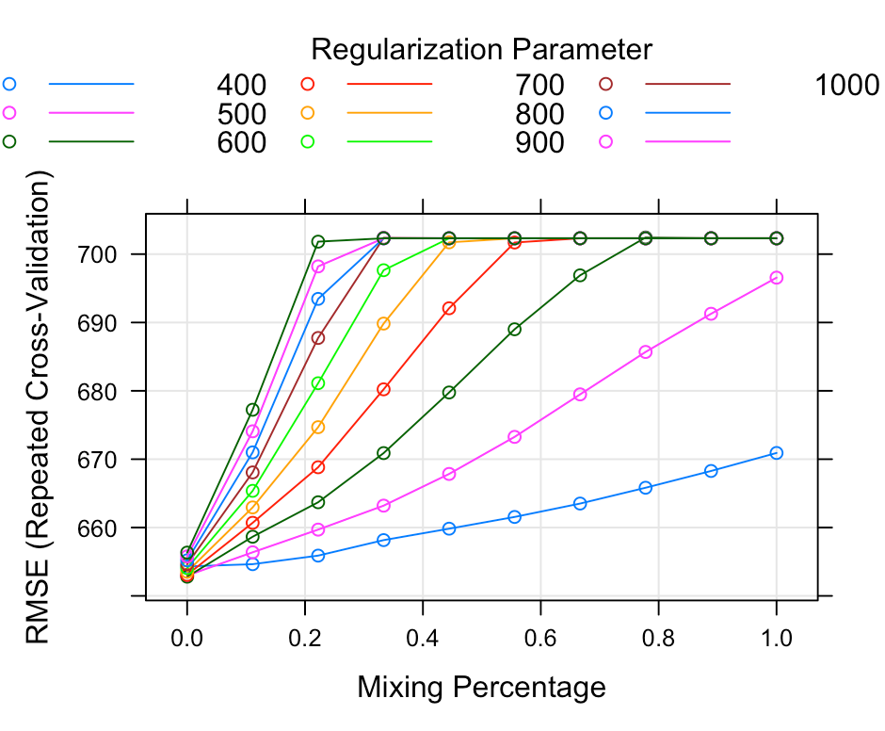
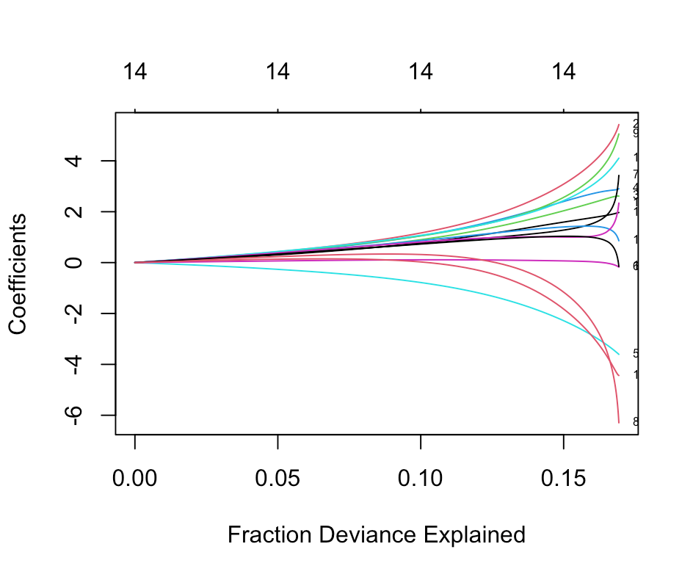
Determining parameters for left eye
Alpha=0, lambda= 400

Slide 7
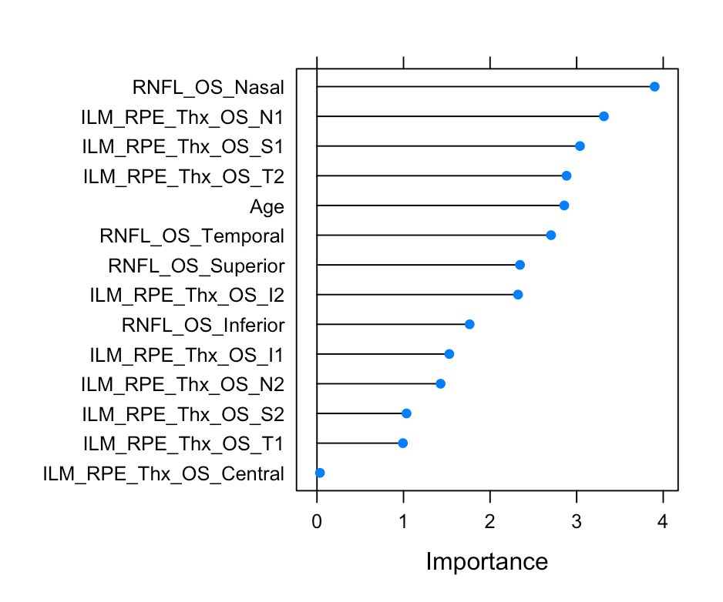
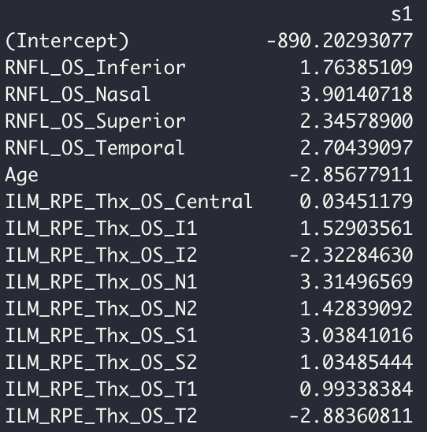
Importance of variables and coefficients (OS)

Slide 8
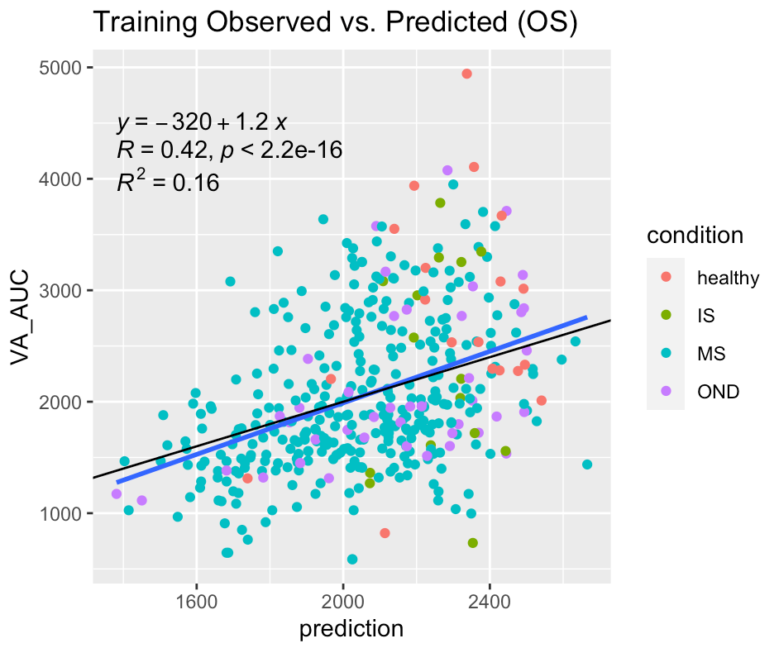
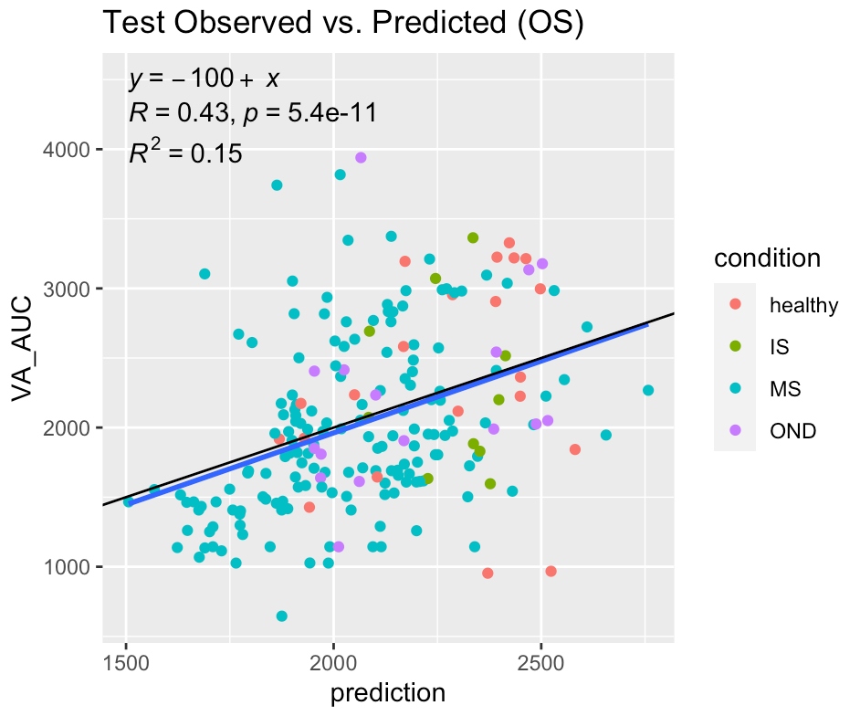


Fit for Training vs. Testing data for left eye
RMSE ->
*black line is y=x reference line, blue line is regression line

